Slide 1

Your past. Your present. Your future.
Notes:
I would like you to try and remember your happiest memory. Now, think about yourselves 40 years from now. You may no longer remember that moment. Wouldn’t you like to capture those moments and relive them in the future? That’s what Capsulefy is about.

Slide 2
OVERVIEW
Idea
Team
MVP
Viability study
Technologies
Innovation
Competitors
Pilot users
Costs
Conclusions

Slide 3
IDEA

Slide 4





IDEA

Slide 5
IDEA
?

Slide 6
TEAM

Slide 7
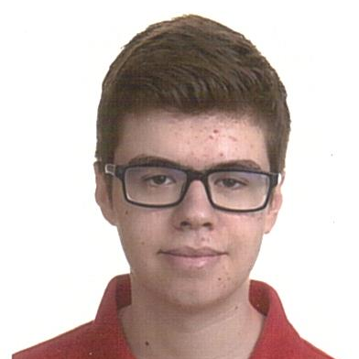



TEAM
Pablo Rebollo
Project manager, backend developer

Slide 8
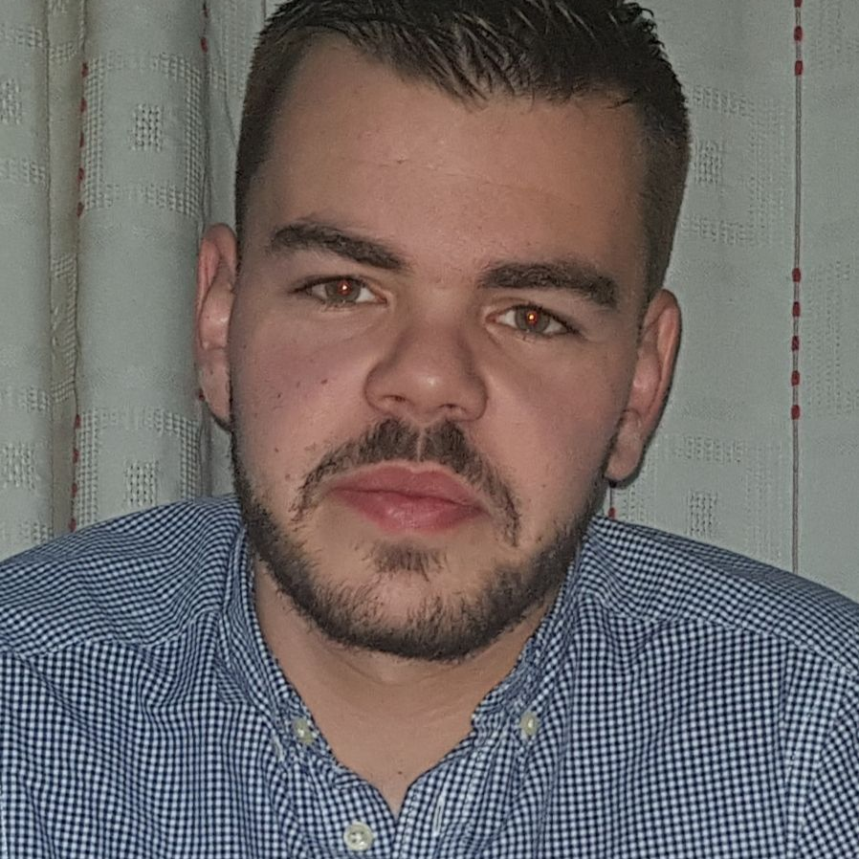


TEAM
Adrián Cantón
Business manager, full-stack developer

Slide 9
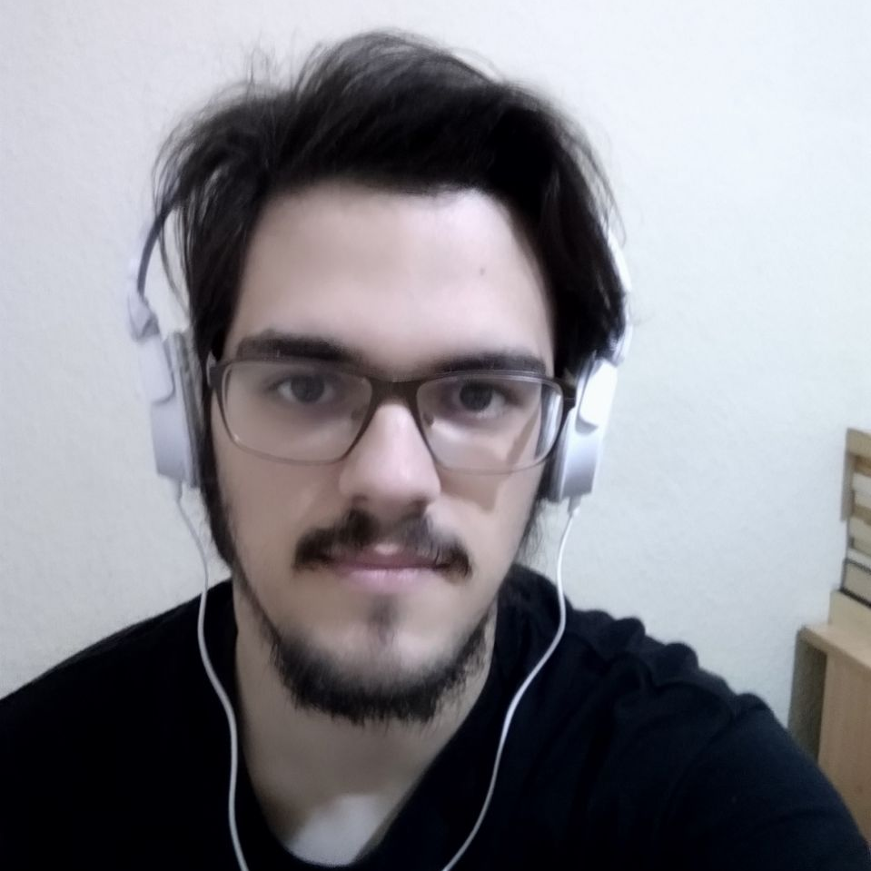

TEAM
Daniel Carpio
Analist, frontend developer

Slide 10
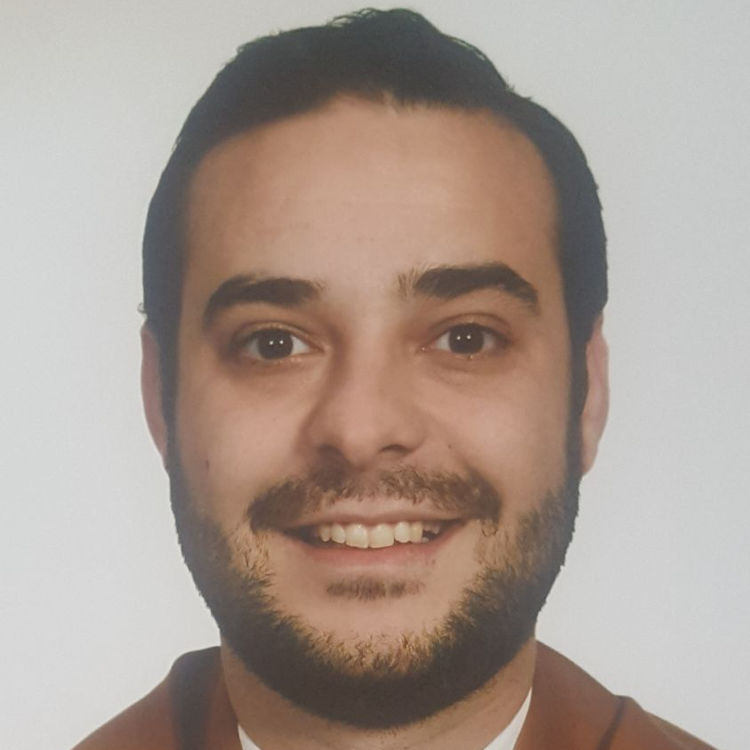

TEAM
Juan Rodríguez
Requirements engineer, backend developer

Slide 11


TEAM
Rafael Fresno
Backend developer, API integration

Slide 12




GOALS

Slide 13




KNOWLEDGE MANAGEMENT

Slide 14
MVP

Slide 15
MVP
Payment
Core use cases
Basic admin
Registration

Slide 16
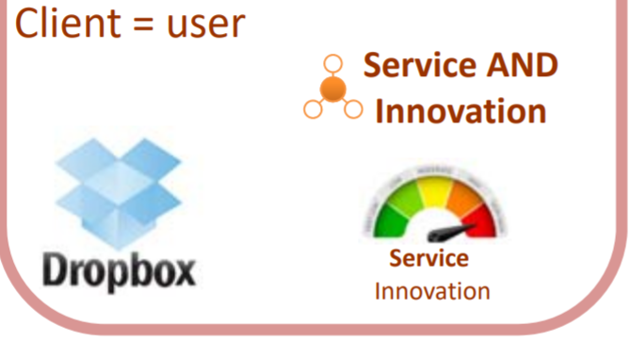
CLASSIFICATION

Slide 17

CORE USE CASES
Refresh deadman switch
Select type of capsule
<<includes>>
Unregistered user
Registered user
Pay for a
capsule

Slide 18
CORE USE CASES
Delete
capsule
Create free
capsule
Unregistered user
View
capsule
Registered user

Slide 19

MOCKUPS
https://marvelapp.com/4395g15/screen/53795517

Slide 20


PAYMENT PLANS
 | Free | Premium
Price | 0 € | 10 €/year
Space | 10 MB/user | 100 MB/capsule
Social network and email integration
Capsule scheduling | Up to 1 year | Depends on subscription
Open capsule duration | 6 months | 1 year after subscription expiration
Duration extension

Slide 21
VIABILITY STUDY

Slide 22
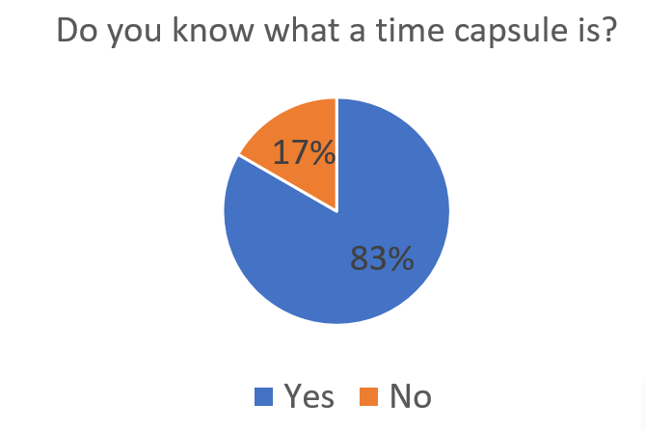
VIABILITY STUDY

Slide 23
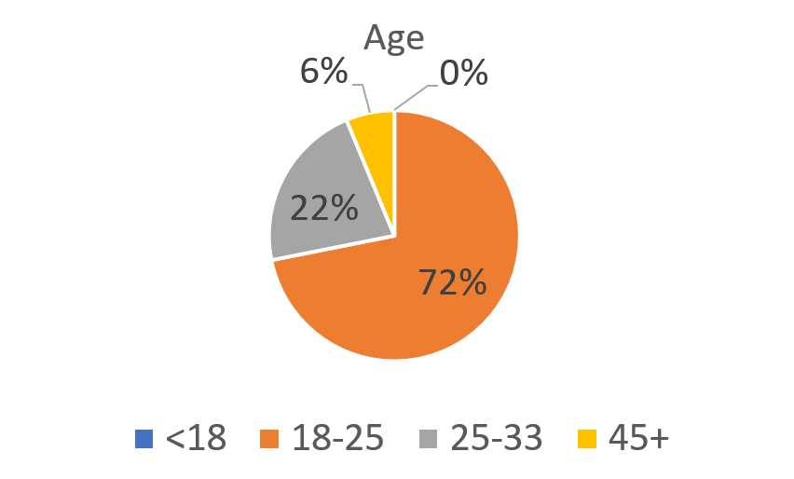
VIABILITY STUDY

Slide 24
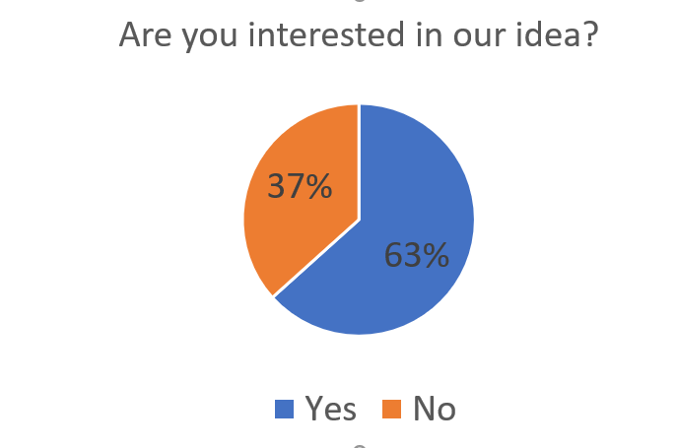
VIABILITY STUDY

Slide 25
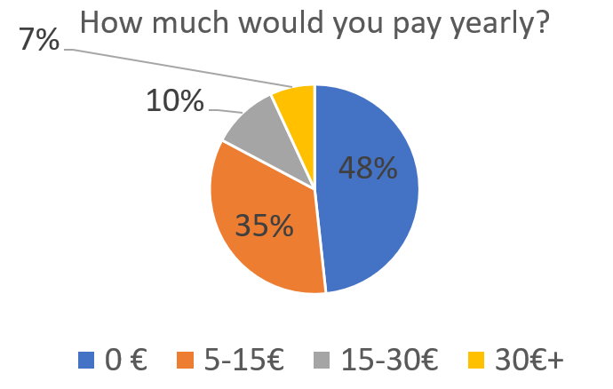
VIABILITY STUDY

Slide 26
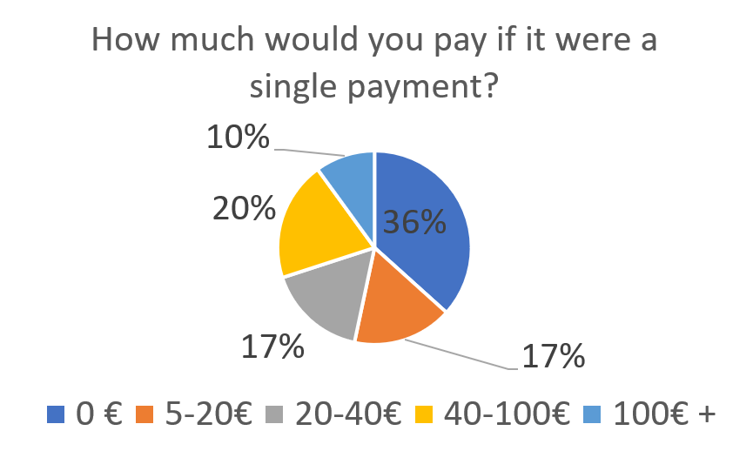
VIABILITY STUDY

Slide 27
TECHNOLOGIES

Slide 28





TECHNOLOGIES
Main web app
Users and capsules APIs
Social media APIs

Slide 29

TECHNOLOGIES
?

Slide 30

CONTINUOUS INTEGRATION

Slide 31
INNOVATION

Slide 32


INNOVATION
High service innovation
Notes:
Communication with social media sites using custom messages. Dead man switch.

Slide 33
COMPETITORS

Slide 34
COMPETITORS
 | Viajeros en el tiempo | Mytimecapsule | Miigen | thetimecapsule | Capsulefy
Automatic content publication
Free version
Premium version
Images
Videos
Social network interaction
Dead man switch

Slide 35
PILOT USERS

Slide 36
PILOT USERS
Francisco R.
Javier A.
Valentin A.
Antonio G.
José Manuel J.
Sandra C.
José Manuel D.

Slide 37
COSTS

Slide 38


COSTS
Realistic: 34348,71 – 43554,24 €
Optimistic: 27105,61 €
Pesimistic: 60474,63 €
Notes:
Factors taken into account: salaries, workplace, hosting, adversitement.

Slide 39





RISKS
Notes:
Computers not working, contracts changing, servers down, incompatible schedules, negative reception and losses.

Slide 40
CONCLUSIONS

Slide 41
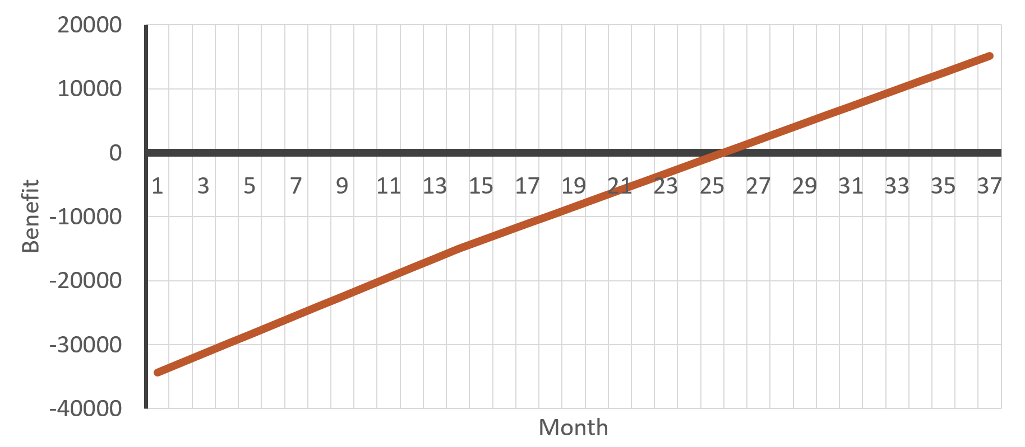
CONCLUSIONS

Slide 42
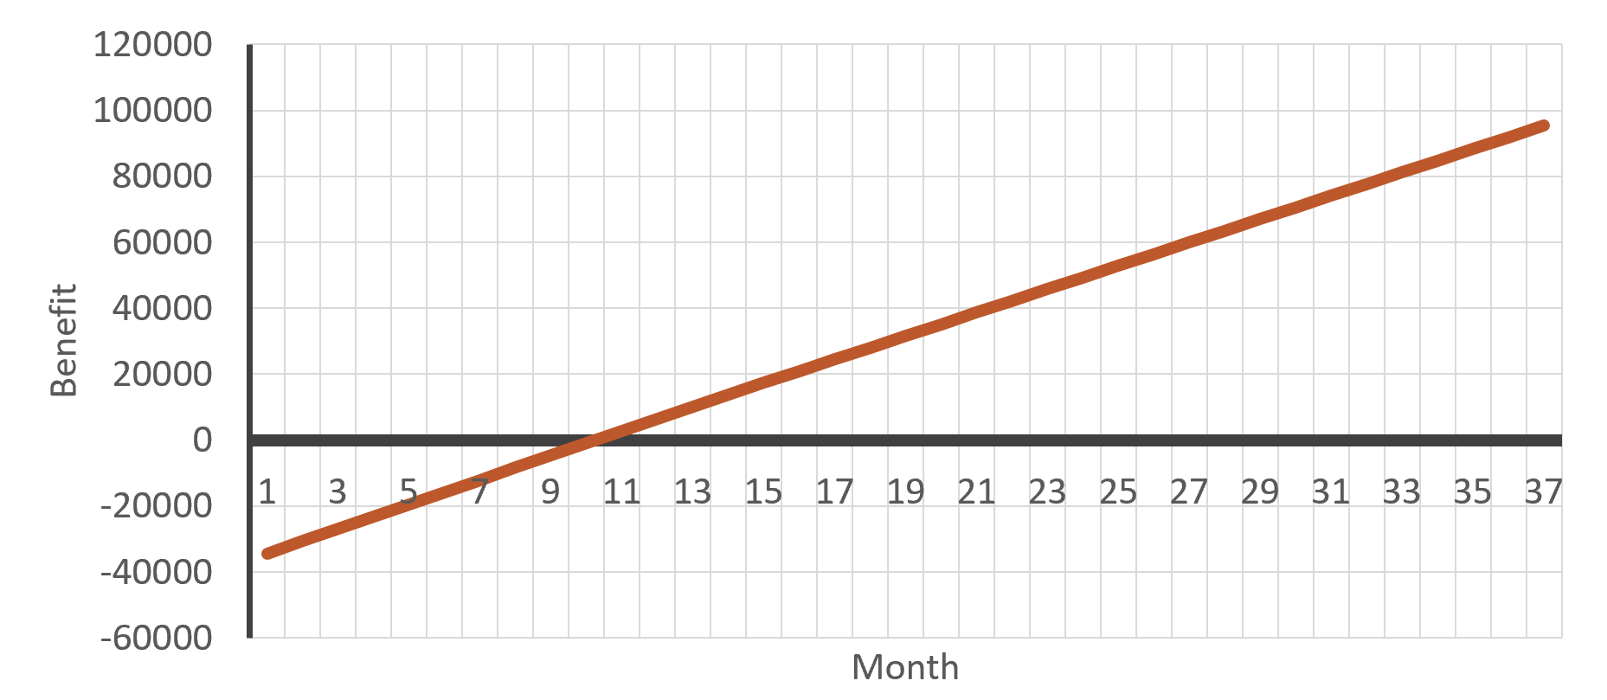
CONCLUSIONS

Slide 43
THANKS!
Notes:
Insurance companies: offer capsules to their clients, with no expiration and special prices. Create endpoint for insurances to send their client data.

